Slide 1

Project Title: Automated Defect Detection in
Ferrules for Quality Control
NAME | PRN | ROLL NO | E-MAIL
VIRENDRA PARDESHI | 22210908 | 352029 | virendra.22210908@viit.ac.in
KUNAL JADHAV | 22211100 | 352014 | kunal.22211100@viit.ac.in
TANVI PATIL | 22210259 | 352032 | tanvi.22210259@viit.ac.in
Department of Mechanical Engineering
BRACT’S, VISHWAKARMA INSTITUTE OF INFORMATION TECHNOLOGY,PUNE-48
(An Autonomous Institute affiliated to Savitribai Phule Pune University)
(NBA and NAAC accredited, ISO 9001:2015 certified)

Slide 2

Quality Control in Manufacturing
Quality control in manufacturing is a crucial process that ensures products meet predefined standards and specifications.
It plays a vital role in delivering high-quality goods to customers, minimizing production losses, and maintaining brand reputation.
Quality control methods are implemented at various stages of production, including raw material inspection, in-process checks, and final product evaluation.
Effective quality control practices are essential for any manufacturing organization, regardless of its size or industry.

Slide 3
Common Quality Control Methods
1
Statistical Process Control (SPC)
2
Acceptance Sampling
SPC uses statistical techniques to monitor and control manufacturing processes, aiming to identify and eliminate sources of variation that could lead to product defects. It involves collecting data, analyzing trends, and applying corrective actions to maintain consistent product quality.
Acceptance sampling involves inspecting a random sample of products from a batch to determine the quality of the entire batch. This method is often used when it is impractical or cost-prohibitive to inspect every single product. It relies on statistical calculations to make decisions about accepting or rejecting the batch.
3
Visual Inspection
4
Dimensional Inspection
Visual inspection is a basic method that relies on human observation to detect defects. It is often used for simple checks, such as verifying the color, shape, or size of products. However, it can be subjective and prone to human error, especially in situations where subtle defects are difficult to see.
Dimensional inspection uses specialized measuring tools, such as calipers, micrometers, and coordinate measuring machines (CMMs), to verify the dimensions of products. This method ensures that products meet precise tolerances and specifications, which are critical for their functionality and performance.

Slide 4
Literature survey:
Sr.no | Title | Author
1. | Automated Defect Detection in Physical Components using Machine Learning | Sunny Behal, Japinder Singh | The paper discusses automated defect detection in physical components using machine learning. It highlights the transition from manual inspection, which is prone to errors, to machine learning approaches that improve detection speed and accuracy. The authors propose a model based on the MobileNet-SSD architecture, optimized for resource efficiency, which outperforms traditional deep learning methods in defect detection. The paper describes the model's development, pre-processing techniques, and training on datasets. Results show higher precision in detecting surface defects with minimal computational resources.
2. | Automated defect recognition in X-ray projections using neural networks trained on simulated and real-world data | Tobias Schon, Rasmus Hvingel by, Bishwajit Goswami | The paper explores using neural networks to detect defects in X-ray images of light metal castings. It compares training on simulated versus real-world data, concluding that a combination of both yields the best results. The closer simulated data matches real-world conditions, the better the defect detection performance. This method aims to reduce the costs of real-world data collection and setup.
3. | Automated 3D Defect Detection based on Simulated Reference | Dr. Frank Sukowski, Daniel Suth, Adrian Waldyra | The paper presents a method for automated 3D defect detection using simulated reference parts in industrial CT scans. It overcomes challenges like limited scan time and image artifacts by comparing parts to simulated "flawless" models, enhancing defect detection accuracy. This approach eliminates the need for real defect-free parts, improving reliability in noisy environments, especially for automotive components

Slide 5
4. | Automated Machine Learning System for Defect Detection on Cylindrical Metal Surfaces | Yi-Cheng Huang, Kuo-Chun Hung, Jun-Chang Lin | The paper presents an Automated Machine Learning (AutoML) system for defect detection on cylindrical metal surfaces using deep learning models like VGG-16, ResNet-50, and MobileNet. The study compares Transfer Learning (TL) and AutoML approaches. The AutoML model, combining modules from these networks, achieved 95.5% accuracy, while AutoKeras, another AutoML tool, reached 99.83% accuracy. This system reduces manual effort and improves accuracy in defect detection for smart manufacturing.
5. | Automated Fabric Defect Detection | Henry Y.T Ngan, Grantham Kwok Hung Pang | The paper provides a review of automated fabric defect detection methods, classifying them into motif-based and non-motif-based approaches. It compares seven detection techniques, outlines their strengths and weaknesses, and discusses future research directions.
6. | Automatic measurement of contact angle in pore-space images | Ahmed AlRatrout , Ali Q Raeini, Branko Bijeljic, Martin J Blunt | This method measures in-situ contact angles between immiscible fluids using segmented pore-scale X-ray images. It identifies and meshes fluid/fluid and fluid/solid interfaces, applies Gaussian smoothing, and tracks the three-phase contact line to compute contact angles using vector dot products. The technique is validated with synthetic images and applied to oil/brine systems under reservoir conditions, producing highly accurate contact angle measurements. It offers a rapid, precise characterization of pore-scale wettability, crucial for improving hydrocarbon recovery and carbon dioxide storage.
7. | Automated Dimension Measurement System | Shubham Kakirde, Shubham Jain, Swaraj Kaondal, Reena Sonkusare, Rita Das | Efficient warehouse management is crucial for modern supply chains, especially with the rise of e-shopping. Many warehouses still use manual labor for tasks like measuring object dimensions, which is slow and inefficient. In a post-Covid world, automated, contactless systems are becoming more important for safety and efficiency. A proposed solution involves using a single line laser and camera module to quickly and accurately measure object dimensions using 3D reconstruction. This method balances accuracy, speed, and power consumption, making it well-suited for industrial applications.

Slide 6
8. | Research in automated measurement of project performance indicators | Ronie Navon | Recent research in Construction Automation (CA) has shifted towards Automated Project Performance Control (APPC), which uses Automated Data Collection (ADC) technologies to monitor project performance indicators in real-time, such as cost, schedule, and productivity. Traditional manual data collection methods are labor-intensive, error-prone, and slow, limiting real-time control. Technologies like barcodes, RFID, GPS, video, and LADAR are being explored to automate data collection, enabling more accurate and efficient project control. These innovations aim to improve construction management by providing real-time feedback, helping address deviations more effectively.
9. | Camera based automatic system for tool measurement and recognition | Adam Mrozinski, Adam Klodowski | Recent advancements in video capture technology have led to the development of automated video-based systems for monitoring and analyzing construction tools and equipment. These systems utilize high-quality video cameras to collect data in real-time, allowing for efficient analysis of operational metrics. By integrating image processing algorithms with user-friendly software, these systems enhance the identification and performance assessment of tools. The paper highlights the benefits of utilizing such technologies, emphasizing their practical implications in improving monitoring processes and overall operational efficiency in construction environments.
10. | Automatic measurements of garment sizes using computer vision deep learning models and point cloud data | Seounggeun Kim , Haejun Moon , Jaehoon Oh , Yonghak Lee , Hyun Kwon, and Sunghwan Kim | This paper proposes an automated garment size measurement method that combines deep learning models with LiDAR point cloud data. By using a mobile device equipped with both a camera and a LiDAR sensor, the approach captures 2D images and 3D spatial information simultaneously, enabling accurate distance calculations for clothing size measurements. The method shows high precision, with average relative errors of 1.59% and 2.08% in various environments. This innovative technique addresses the limitations of traditional methods, streamlining the sizing process in the fashion industry while minimizing labor costs and reducing sizing discrepancies for consumers.

Slide 7
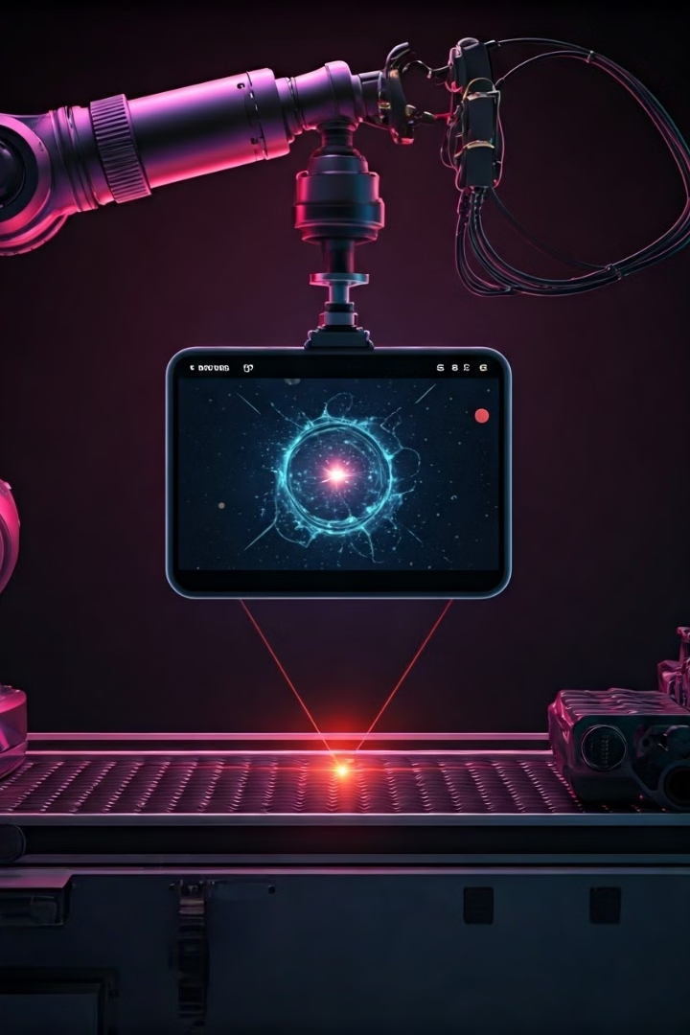
Automated Defect Detection Technique
Machine Vision Systems
Non-Destructive Testing (NDT)
Ultrasonic Testing (UT)
Vision Measurement Machine

Slide 8
Machine Vision Systems:
Advantages :
Accuracy: Consistently captures and processes visual data with high precision, reducing human error.
Speed: Performs inspections and measurements faster than human operators.
Non-contact Measurement: Allows measurements without physical contact, preventing damage to delicate components.
Automation: Integrates easily into automated production lines, increasing productivity.
Disadvantages :
Initial Cost: High setup cost due to advanced hardware and software.
Complex Setup: Requires specialized expertise for configuration and maintenance.
Environmental Sensitivity: Performance can be affected by lighting conditions, reflections, and other environmental factors.
Limited Flexibility: May require adjustments or retraining when products or environments change significantly.

Slide 9
2.Non-Destructive Testing (NDT):
Advantages :
Preservation of Material: Tests are conducted without causing any damage to the tested components, allowing their
continued use.
Early Detection: Identifies defects and flaws early in the production or operational stages, preventing failures.
Cost Efficiency: Reduces repair and downtime costs by detecting issues early without interrupting operations.
Safety Enhancement: Improves the safety of structures, machinery, and systems by ensuring integrity without destructive
processes.
Disadvantages :
Complex Interpretation: Requires specialized knowledge and expertise to interpret results accurately.
Initial Equipment Cost: High cost of advanced NDT equipment and training.
Surface Limitations: Some NDT methods may be limited to detecting surface or near-surface defects, missing internal issues.
Time-Consuming Setup: Proper preparation and calibration can be time-consuming depending on the method used.

Slide 10
3.Ultrasonic Testing (UT):
Advantages :
High Accuracy: Provides precise measurements of flaw size and location, enhancing reliability in inspections.
Non-Destructive: Allows the inspection of materials without causing any damage to the object being tested.
Immediate Results: Delivers real-time feedback, enabling quick analysis and decisions.
Deep Penetration: Can detect internal defects deep within a material, making it highly effective for thick or dense objects.
Disadvantages :
Requires Skilled Technicians: Accurate interpretation of results requires trained and experienced personnel.
Surface Requirements: The surface must be well-prepared (clean and smooth) for accurate results, and coupling
agents are often needed.
High Equipment Cost: Advanced ultrasonic testing equipment can be expensive to acquire and maintain.
Limited for Complex Shapes: May struggle with irregularly shaped or highly attenuative materials, reducing its
effectiveness in certain applications.

Slide 11
4.Vision Measurement Machine:
Advantages :
High Precision: Provides accurate measurements of small and intricate components, often at micron-level precision.
Non-Contact Inspection: Measures objects without physical contact, avoiding damage or deformation of delicate parts.
Automated Measurements: Increases efficiency by automating the measurement process, reducing human error.
Versatility: Can measure various dimensions like length, width, height, and angles, making it suitable for complex shapes.
Disadvantages :
Expensive Setup: High initial cost for equipment and setup, as well as maintenance.
Requires Controlled Environment: Performance can be affected by lighting, vibration, or temperature fluctuations.
Limited Depth Measurement: Some machines may struggle to measure deep or recessed features accurately.
Skilled Operation Needed: Proper usage and interpretation of results require skilled operators, adding training costs.

Slide 12
VMM:
High Cost: Expensive setup, maintenance, and calibration.
Limited Flexibility: Difficult to adapt to new parts or defects.
Slow Inspection Speed: May not keep up with high-speed production.
Operator Dependency: Requires skilled personnel for operation and calibration.
Limited Flexibility: Difficult to adapt to new parts or defects.
Complex Setup: Lengthy setup and recalibration for new tasks.
ML:
Cost-Effectiveness: Lower long-term costs compared to traditional systems.
Flexibility: Adapts to various defect types and new patterns.
Automation: Enables real-time, automated inspection.
Continuous Improvement: Improves accuracy with more data.
Complex Defect Detection: Identifies subtle and intricate defects.
Versatility: Handles multiple defect types (surface, dimensional, etc.).

Slide 13
Why we choose ML:
High Accuracy in Defect Detection: Machine Learning models (e.g., CNNs) are capable of learning complex patterns, enabling precise identification of subtle defects that are difficult to detect manually.
Automation and Efficiency: Image Processing techniques (e.g., filtering, edge detection) automate feature extraction, speeding up defect analysis and reducing manual effort.
Adaptability: ML models can be trained on new defect types, making the system adaptable to different scenarios and components.
Real-Time Analysis: Integration of ML and IP allows for rapid, real-time defect detection, providing immediate feedback during production.
Reduced Human Error: Automation minimizes human intervention, reducing inconsistencies and ensuring consistent quality control.
Scalability and Flexibility: The combined use of ML and IP can be scaled for different production lines, defect types, and quality assurance needs.

Slide 14
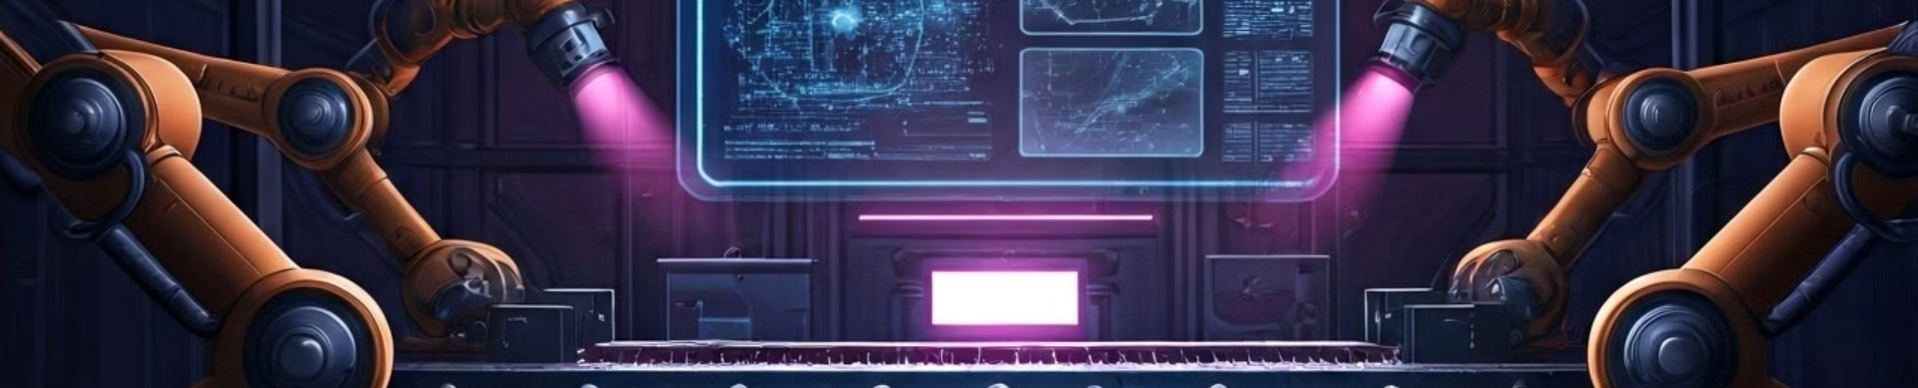
The Case for Machine Learning and Image Processing in Quality Control
Machine learning (ML) and image processing (IP) are emerging technologies that are revolutionizing quality control in manufacturing.
These technologies offer significant advantages over traditional methods by providing greater accuracy, speed, and automation. ML algorithms can be trained to identify subtle defects that are difficult or impossible for human inspectors to detect, while IP techniques can analyze images of products in real-time to identify and classify defects.
These capabilities allow for more effective quality control, resulting in higher product quality, reduced production costs, and improved customer satisfaction.

Slide 15
Implementing ML and IP for Quality Control
Implementing ML and IP for quality control requires a systematic approach that involves several steps:
1
1. Data Collection
The first step is to collect a large dataset of images of products, including both good and defective examples. This dataset will be used to train the ML model.
2
2. Model Training
The ML model is trained on the collected dataset, learning to identify patterns and features that distinguish defective products from good ones. This involves feeding the model images and labels indicating whether each image represents a defective product or not.
3
3. Model Evaluation
After training, the model is evaluated on a separate set of images to assess its accuracy and performance. This ensures that the model is reliable and can accurately identify defects in real-world scenarios.
4
4. System Integration
The trained model is then integrated into the manufacturing process, where it can be used to inspect products in real-time. This integration typically involves connecting cameras and sensors to the system, which capture images of products and feed them to the ML model.
5
5. Continuous Improvement
The performance of the ML and IP system is continuously monitored and improved. This involves collecting feedback from the system's performance, retraining the model with new data, and refining the system's parameters to enhance its accuracy and effectiveness.

Slide 16





How ML and IP Systems Work for Quality Control
ML and IP systems work by analyzing images of products and identifying patterns that indicate defects. The process typically involves the following steps:
1. Image Acquisition
The system acquires images of products using cameras or sensors. These images can be captured in real-time as products move along a conveyor belt or during offline inspection.
2. Image Preprocessing
The acquired images are preprocessed to enhance their quality and remove noise. This step includes operations like resizing, cropping, and converting the images to grayscale or a different color space.
3. Feature Extraction
Features that are relevant for defect detection are extracted from the preprocessed images. These features can include color variations, shape deviations, texture patterns, and other characteristics that distinguish defective products from good ones.
4. Defect Classification
The extracted features are used to classify the products as either good or defective. This is done by comparing the features to patterns learned during the model training process. The system can also categorize defects into different types, such as scratches, dents, or missing parts.
5. Output and Action
The system outputs the classification results, highlighting any detected defects and providing information about their location and type. This information can be used to trigger automated actions, such as rejecting defective products, adjusting manufacturing processes, or alerting operators for further inspection.

Slide 17
The Process of ML and IP-Driven Quality Control
The process of ML and IP-driven quality control involves several steps, from image acquisition to defect identification and action. Here is a detailed overview:
1. Image Acquisition
1
Cameras or sensors are strategically placed on the production line to capture images of products as they move along the conveyor belt. These images can be captured at multiple angles and resolutions to ensure comprehensive inspection.
2
2. Data Preprocessing
The acquired images are preprocessed to remove any noise or distortions that might interfere with defect detection. This includes adjusting brightness, contrast, and color balance, as well as performing image filtering and edge enhancement.
3. Feature Extraction
3
The preprocessed images are analyzed to extract features that are relevant for defect detection. These features can include shape, size, color, texture, and other characteristics that distinguish defective products from good ones. Different feature extraction techniques are available, depending on the type of defects being targeted.
4
4. Defect Classification
The extracted features are fed into a trained machine learning model that classifies the products as either good or defective. The model uses algorithms to identify patterns and anomalies in the features, based on its training data. The classification results can also indicate the type of defect detected.
5. Action
5
Based on the classification results, the system triggers appropriate actions. Defective products can be automatically rejected and sent for rework or disposal. Alternatively, the system can alert operators for manual inspection or adjust manufacturing processes to minimize future defects.

Slide 18
Optimizing Quality Control with ML and IP
ML and IP offer numerous advantages for optimizing quality control in manufacturing. By leveraging these technologies, manufacturers can achieve significant improvements in product quality, efficiency, and cost savings. Key takeaways include:
Increased Accuracy
Improved Efficiency
ML and IP systems can detect subtle defects that are difficult or impossible for human inspectors to see. This leads to higher product quality and reduced customer complaints.
Automated defect detection allows for faster inspection times, enabling manufacturers to process products more efficiently and reduce production delays. This also frees up human inspectors to focus on more complex tasks.
Reduced Costs
Data-Driven Decision Making
By minimizing defects and reducing rework, ML and IP systems can significantly reduce production costs. They also lead to lower labor costs as fewer inspectors are required for manual inspection.
These systems collect valuable data that can be used to identify trends and patterns in product quality. This data can be used to improve manufacturing processes and prevent future defects.

Slide 19
Conclusion:
Summary: Developed an effective automated defect detection system for ferrules,
enhancing quality control.
Key Findings: Achieved high accuracy and efficiency, outperforming manual inspection
methods.
Production Impact: Reduced inspection time and costs while improving product quality.
Future Work: Explore expanding system capabilities and integrating predictive
maintenance features.
Final Thoughts: Demonstrates the transformative potential of automation and AI in
manufacturing quality control.

